Slide 1
Demographic Shifts and Macroeconomic Outcomes: A Distributional Lens
Lisa Kolovich, IMF

Slide 2
Global Trends

Slide 3
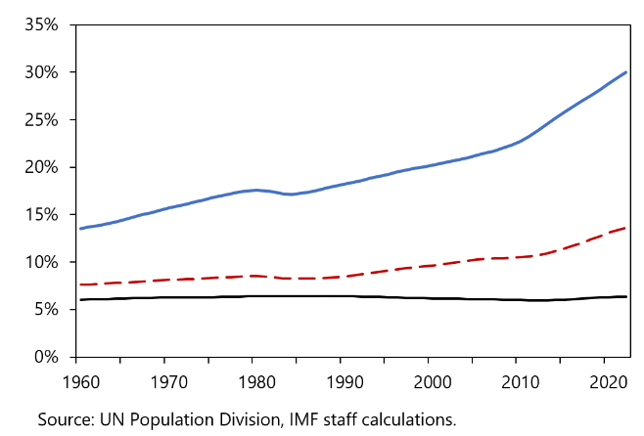
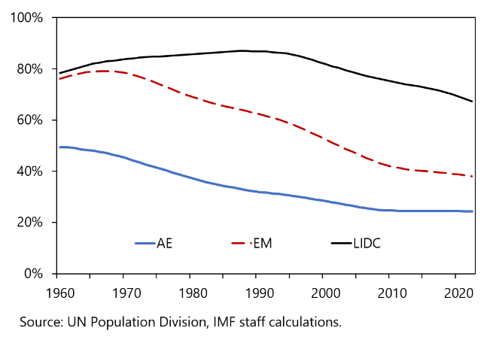
Two diverging demographic trends…
Dependency Ratio, Old
(Population age 64+ compared to working age population)
Dependency Ratio, Young
(Population below age 15 compared to working age population)
Old-age dependency ratios in AEs and EMs have been rising, reflecting longer lifespans and declining birth rates.
Young dependency ratios remain elevated in LIDCs, creating opportunities for demographic dividend.
Note: AE is Advanced Economies; EM, Emerging Markets; and LIDC, Low-income and Developing Countries

Slide 4
The aging trend in AEs and EMs is projected to continue…

Slide 5
…and in low-income and developing countries (LIDCs), the young dependency ratio is projected to remain elevated.

Slide 6
For aging economies, increasing female labor force participation (FLFP) helps mitigate the effects of demographic shifts.
Note: In AEs, we assume FLFP increases such that MLFP-FLFP is no more than 7 percentage points.
Note: In EMs, we assume FLFP increases such that MLFP-FLFP is no more than 10.25 percentage points.
Source: Promoting Gender Equality and Tackling Demographic Challenges

Slide 7
Policies

Slide 8
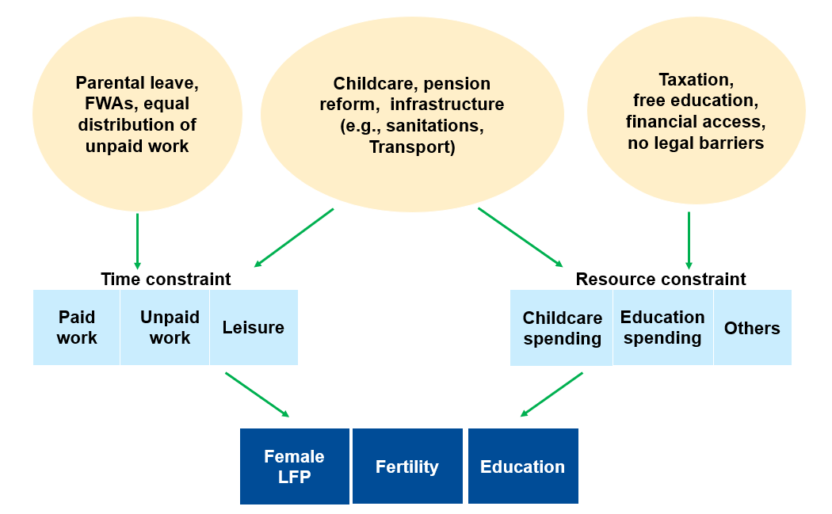
How Do We Think About The Fertility, Human Capital Investment And Work Choices?
Policies should alleviate time and resource constraints.
Notes:
OECD time use data based on people of age between 15 to 64.
Demographics is not a stand-alone issue. The choice of fertility, labor market participation and human capital are linked joint decisions.
When households make these choices, they roughly have two constraints, time allocation and resource allocation. The time constraint, resource constraint, together with the distribution of household bargaining power and preferences shape the fertility and work decisions of households.
This framework allows us to think of the diverging demographic trends in a unified framework.
On the left, we present the time allocation of by male and female. As you see, women tend to spend more time on unpaid work and men tend to spend more time on paid work and leisure.
In a setting where barriers for women to participate in labor market is high, women tend to spend more time in unpaid work. They may have more children, but due to the limited resources, they may choose to invest less in the education of each child.
When we think of policies, we can think about how polices can address each of the constraints:
For example, transportation and road infrastructure could reduce the time women spent on fetching water, and allow them more time for other activates such as paid work, so it could relax both time and resource constraint.
Subsidized schooling can help household overcome the resource constraint and at the same time allow the household member who use to watch the children some free time for other activities.
Designing polices to facilitate women’s work-life choice, increasing female’s participation in the paid economic activities contributes to a more inclusive and resilient macro economy.

Slide 9
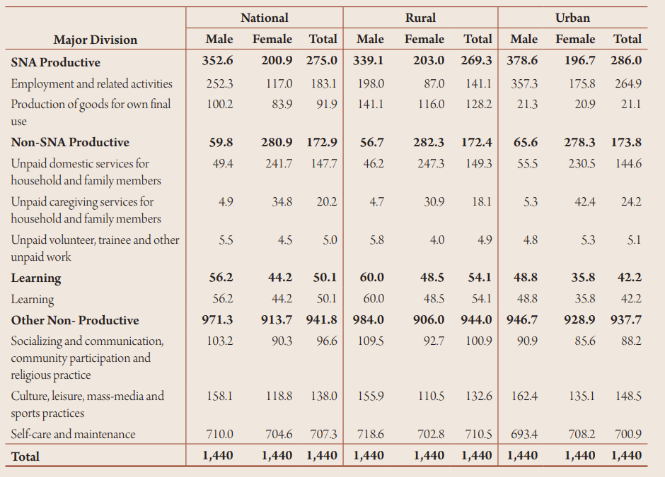
Kenya Time Use Survey Shows Gaps Between Rural, Urban and Men and Women
Key Takeaways
Women spend significantly more time on unpaid care and domestic work, with rural women having the highest burden.
Women also spend less time learning than men.
Men spend more time on socializing/ communication, culture/leisure, and self-care than women.
Gender-disaggregated time use data is essential for designing targeted interventions—rural and urban contexts require tailored policy responses.
Source: Kenya - 2021 Kenya Time Use Survey
Notes:
OECD time use data based on people of age between 15 to 64.
Demographics is not a stand-alone issue. The choice of fertility, labor market participation and human capital are linked joint decisions.
When households make these choices, they roughly have two constraints, time allocation and resource allocation. The time constraint, resource constraint, together with the distribution of household bargaining power and preferences shape the fertility and work decisions of households.
This framework allows us to think of the diverging demographic trends in a unified framework.
On the left, we present the time allocation of by male and female. As you see, women tend to spend more time on unpaid work and men tend to spend more time on paid work and leisure.
In a setting where barriers for women to participate in labor market is high, women tend to spend more time in unpaid work. They may have more children, but due to the limited resources, they may choose to invest less in the education of each child.
When we think of policies, we can think about how polices can address each of the constraints:
For example, transportation and road infrastructure could reduce the time women spent on fetching water, and allow them more time for other activates such as paid work, so it could relax both time and resource constraint.
Subsidized schooling can help household overcome the resource constraint and at the same time allow the household member who use to watch the children some free time for other activities.
Designing polices to facilitate women’s work-life choice, increasing female’s participation in the paid economic activities contributes to a more inclusive and resilient macro economy.

Slide 10
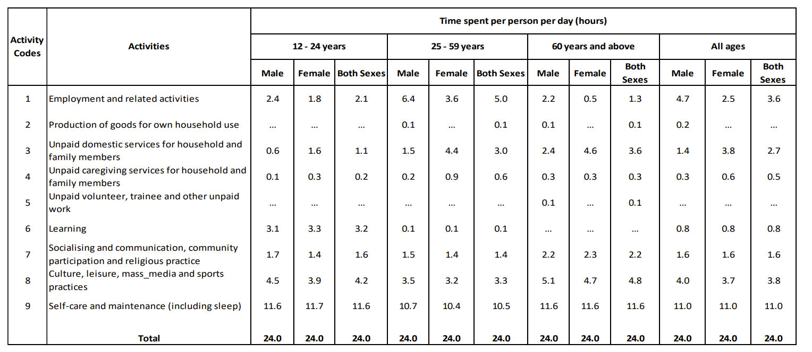
Mauritius time use data also points to gender gaps.
Key Takeaways
Unpaid care work represents a significant share of GDP across sub-Saharan Africa—ranging from about 3 percent in Mauritius to over 8 percent in Madagascar—yet remains excluded from national income measurement.
Women bear a disproportionate share of this burden, with their unpaid care contributions consistently exceeding those of men across all countries in the sample.
Market-based income measures understate the returns to public investment in time-saving infrastructure and care services, as the resulting gains in women’s productivity and labor supply are not fully captured.
Improved sex-disaggregated time use data collection is needed to inform more effective policy design, given considerable heterogeneity across countries and contexts.
Source: TUS_report_Year_2018-19_050321.pdf
Notes:
OECD time use data based on people of age between 15 to 64.
Demographics is not a stand-alone issue. The choice of fertility, labor market participation and human capital are linked joint decisions.
When households make these choices, they roughly have two constraints, time allocation and resource allocation. The time constraint, resource constraint, together with the distribution of household bargaining power and preferences shape the fertility and work decisions of households.
This framework allows us to think of the diverging demographic trends in a unified framework.
On the left, we present the time allocation of by male and female. As you see, women tend to spend more time on unpaid work and men tend to spend more time on paid work and leisure.
In a setting where barriers for women to participate in labor market is high, women tend to spend more time in unpaid work. They may have more children, but due to the limited resources, they may choose to invest less in the education of each child.
When we think of policies, we can think about how polices can address each of the constraints:
For example, transportation and road infrastructure could reduce the time women spent on fetching water, and allow them more time for other activates such as paid work, so it could relax both time and resource constraint.
Subsidized schooling can help household overcome the resource constraint and at the same time allow the household member who use to watch the children some free time for other activities.
Designing polices to facilitate women’s work-life choice, increasing female’s participation in the paid economic activities contributes to a more inclusive and resilient macro economy.

Slide 11
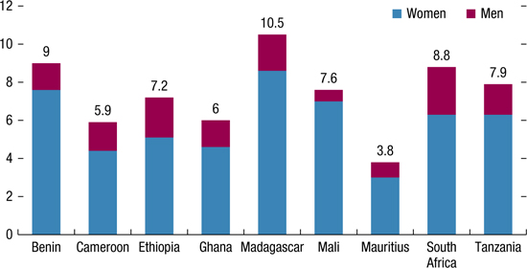
Both men and women perform unpaid care work, but it is not captured in GDP measures.
Value of Unpaid Care Work as a Percentage of GDP, US Dollar PPP 2011, by Gender and Country
Source: Chapter 17 Gender Inequality and Care Work: Valuing and Investing in Care in: Gender Equality and Economic Development in Sub-Saharan Africa
Notes:
OECD time use data based on people of age between 15 to 64.
Demographics is not a stand-alone issue. The choice of fertility, labor market participation and human capital are linked joint decisions.
When households make these choices, they roughly have two constraints, time allocation and resource allocation. The time constraint, resource constraint, together with the distribution of household bargaining power and preferences shape the fertility and work decisions of households.
This framework allows us to think of the diverging demographic trends in a unified framework.
On the left, we present the time allocation of by male and female. As you see, women tend to spend more time on unpaid work and men tend to spend more time on paid work and leisure.
In a setting where barriers for women to participate in labor market is high, women tend to spend more time in unpaid work. They may have more children, but due to the limited resources, they may choose to invest less in the education of each child.
When we think of policies, we can think about how polices can address each of the constraints:
For example, transportation and road infrastructure could reduce the time women spent on fetching water, and allow them more time for other activates such as paid work, so it could relax both time and resource constraint.
Subsidized schooling can help household overcome the resource constraint and at the same time allow the household member who use to watch the children some free time for other activities.
Designing polices to facilitate women’s work-life choice, increasing female’s participation in the paid economic activities contributes to a more inclusive and resilient macro economy.

Slide 12
Data

Slide 13
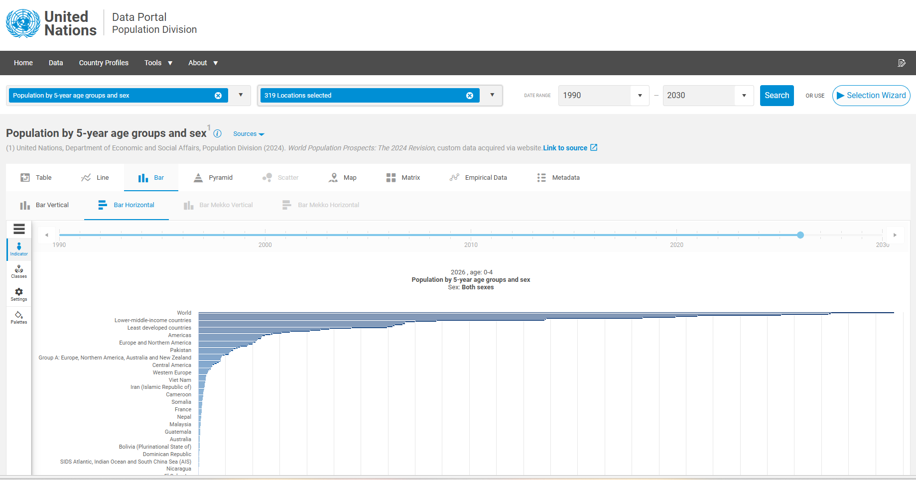
UNDP Data Portal: Home Page | Data Portal

Slide 14
Thank you!

